Slide 1
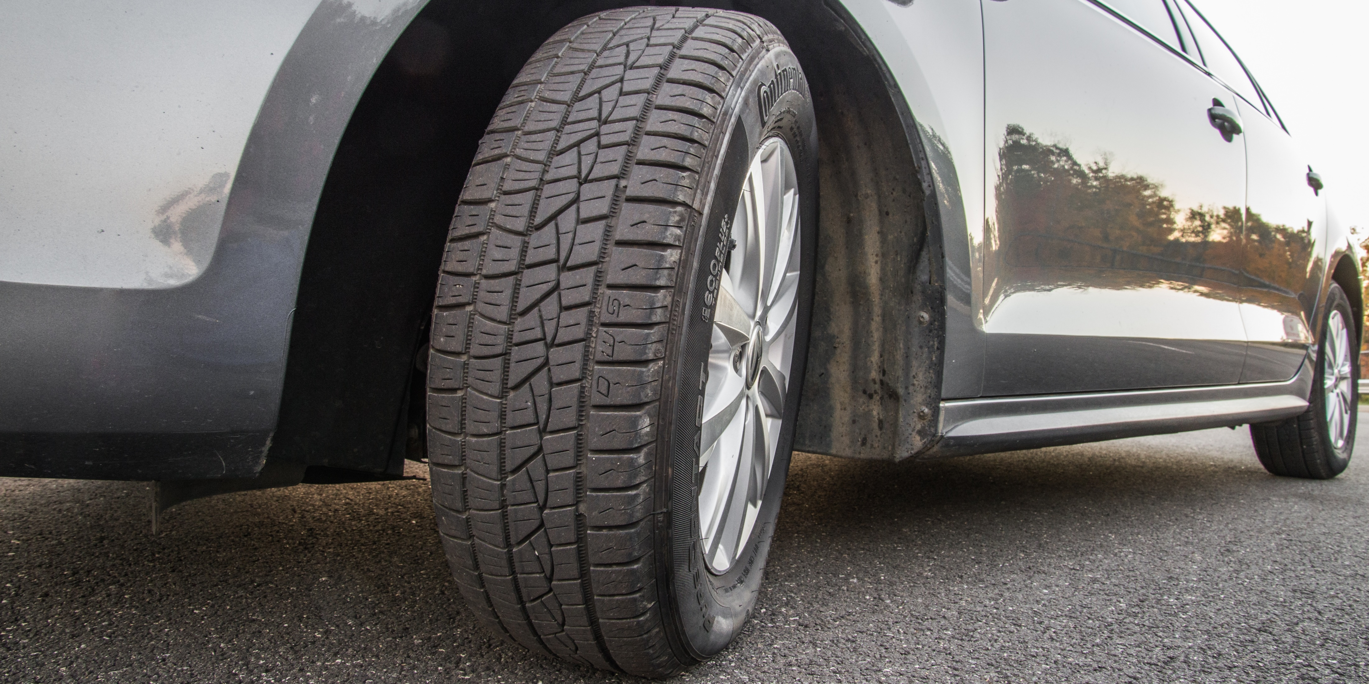
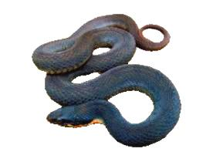
Life in Christ
Introduction to Christian Morality
Notes:
Introduction to Christian Morality—How we live our life in Christ.
Where the rubber meets the road
When we really decide to be a disciple of Jesus Christ
Just saying I believe doesn’t cost anything

Slide 2
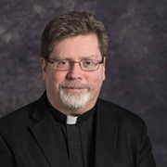

Introduction: Fr. Mike Comer

Slide 3
Dignity!
Most basic principle of our moral life is the awareness that every person bears the dignity of being made in the image of God!
Human Life is Sacred!
Notes:
Our dignity is not something I did
Nothing we can lose
Not based on accomplishments
I am valuable to God not because I am good—But that GOD is GOOD
Fr Comer…..

Slide 4
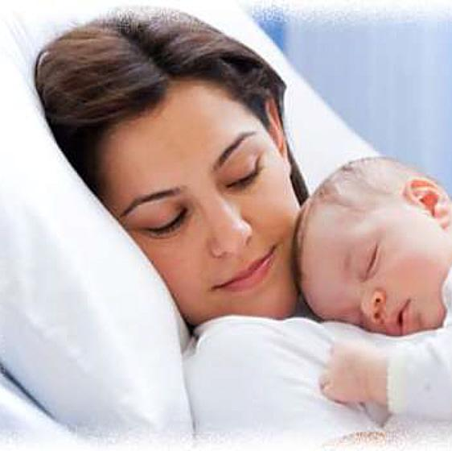
Values….
What is the WORTH of something?
A VALUE is a good worth pursuing, worth committing oneself to, and worth passing on to the next generation
Values “get us out of our seats”—galvanize us to act to protect and promote what we know is GOOD

Slide 5
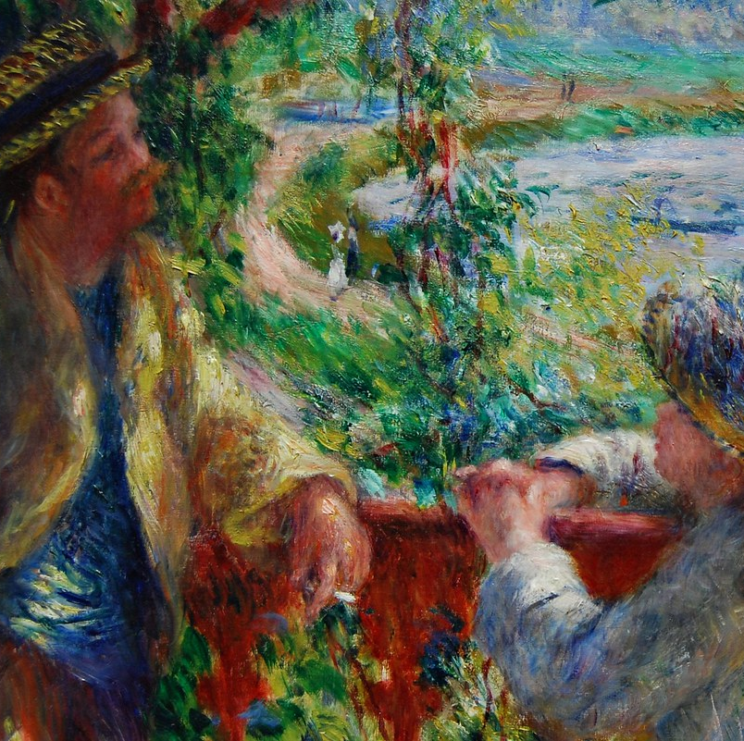
Intrinsically Valuable
Life
Truth
The human person
This Photo by Unknown Author is licensed under CC BY-NC

Slide 6
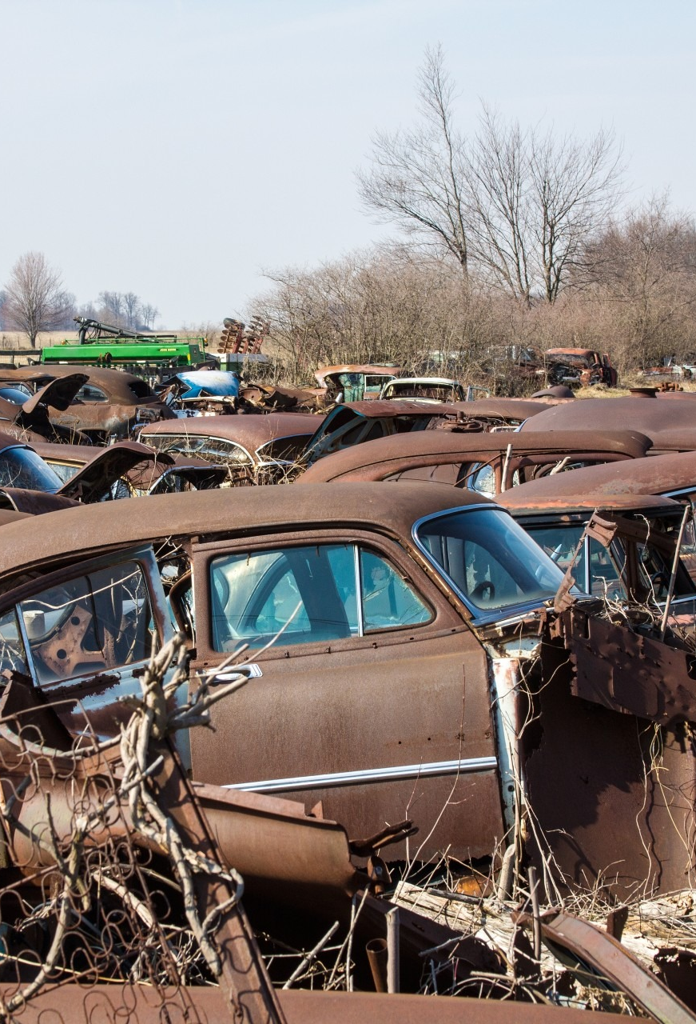
Instrumental Value
Automobile—is worth something (it has value)
  Value for its practical use, perhaps as well its beauty
  But—no one sheds a tear when you pass an auto junk yard

Slide 7
Question:
How do you know if something is right or wrong?
Can you think of some broad categories of things that you would always consider wrong?

Slide 8
Moral Act
Objective Act (What we do)
Must be morally good. Some are always wrong: direct killing of the innocent, torture, rape (Intrinsically evil)
Subjective Goal (Why we do)
The goal or intention of why we do
Intention must be morally good (the end does not justify the means)
Concrete Situation or circumstances (Secondary)
Increase or decrease the goodness or badness of the act
May affect one’s personal moral responsibility for the act

Slide 9
Gift of Free Will
Our choice to do good or evil
God never forces us to do His will
Our responsibility for an action might be compromised
  By ignorance
  By fear
  Other phycological or social factors

Slide 10
Sin is Real!
Interior look: acknowledge our own sinfulness
We need God’s mercy
Sin is an offense against God as well as neighbor and is therefore wrong

Slide 11
Gravity or Seriousness of the Sin
Mortal Sin:
  Grave matter Full knowledge Deliberate consent (freedom)
Mortal sin destroys the loving relationship with God that we need for eternal happiness
Results in loss of God’s grace
Merits Eternal punishment in Hell—exclusion from God’s kingdom

Slide 12

Gravity or Seriousness of Sin
Venial Sin: departure from morality in a less serious matter
  “All wrongdoing is sin, but there is sin that is not deadly” (1 John 5:17)
  Weakens love and impedes our progress in the practice or moral virtue
  Over time can have serious consequences
Notes:
Think of a microscopic virus….will replicate might eventually kill

Slide 13
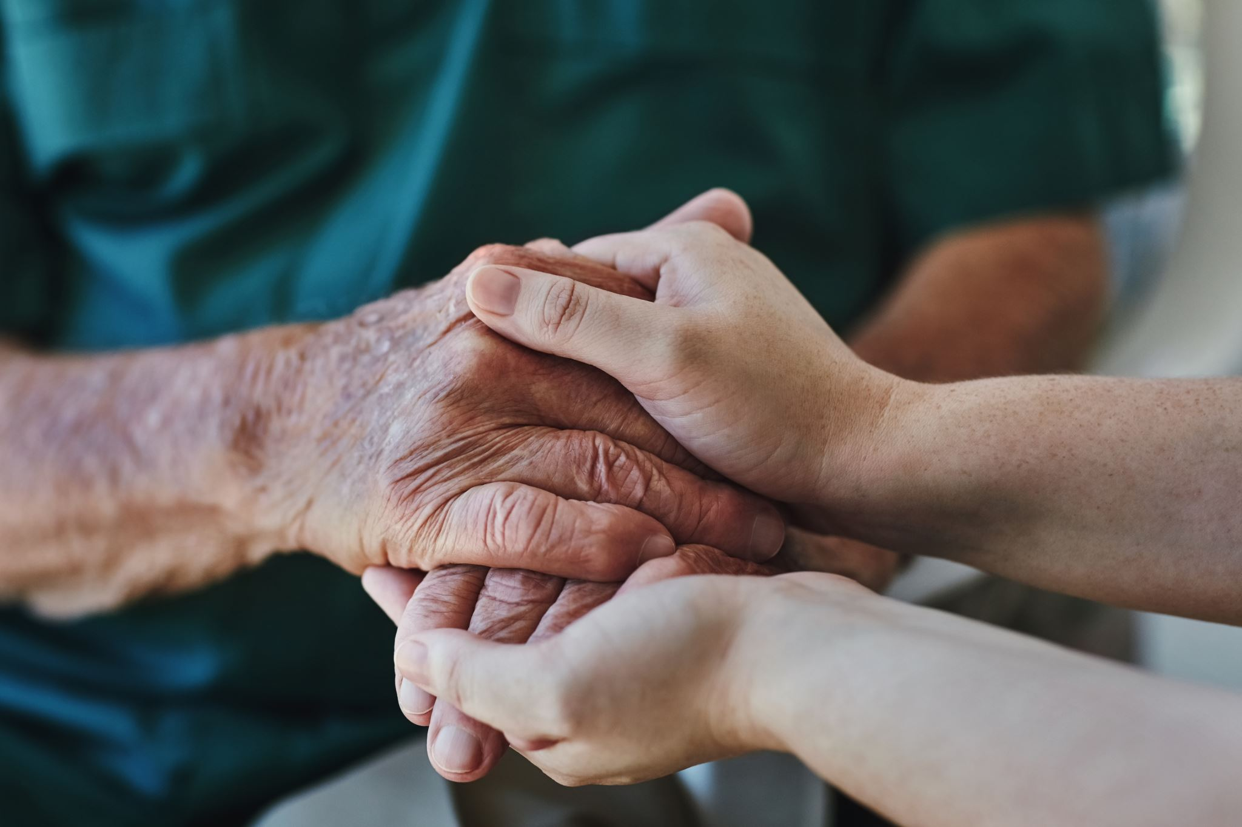
Trust in God’s Mercy
Sorrow & Confession of sin are signs of conversion of heart
  Opens us to God’s mercy
Cannot judge another person
  We cannot know the extent of another’s knowledge and freedom
  Always entrust to the mercy of God

Slide 14
Conscience==requires formation
The judgement of reason by which we recognize the moral quality of a concrete act
A general ability to know right from wrong….BUT
Good conscience requires lifelong formation
How?
  Word of God: Study, Prayer and Practice
  Prudent advice and good example of others
  Authoritative teaching of the Church

Slide 15
“Certain Conscience” can be wrong
Ash Wednesday example in Catechism
  Think it is a Holy Day of Obligation
  Choose to miss Mass anyway
Has a certain conscience subjectively—but incorrect objectively
Therefore, would be a sin

Slide 16
Some rules:
Must follow a certain conscience
An incorrect conscience must be changed if possible
Do not act with a doubtful conscience

Slide 17
Virtues: Habitual disposition to do good
Human virtues form the soul with the habits of mind and body that support moral behavior, control passions, and avoid sin
Virtues guide our conduct
Compassion
  Responsibility
    Sense of duty
      Self-discipline
        Honesty
          Loyalty
            Friendship
              Courage
                Persistence

Slide 18
Theological Virtues
Faith, Hope, and Charity (love)
Relate directly to God
Not acquired, but infused within us a gift from God
  Beginning with Baptism

Slide 19
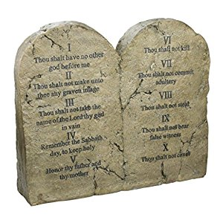
God’s Law
God brings creation into being
  Physical world acts according to God’s plan found
  in the physical laws of nature
Natural Law expresses the original moral sense
  Enables us to discern by reason the good and the evil
  The law within us
10 Commandments: “the privileged expression of the natural law”
Natural Law is unchangeable: not affected by the currents from cultural ideas and customs

Slide 20
The sin of Relativism
The position that there is no objective truth, only subjective opinions
Fails at the outset:
  If no objective truth—that statement cannot be true
Undermines the distinction between truth and lies
Leads to environment of deceit
God is the source of truth

Slide 21
Relativism is alive and thriving
“it basically goes like this. We have relativism. You believe what you want to believe. I believe what I want to believe. If you dare say it ought to be different, if you dare say I shouldn’t believe something or that I ought to believe something that you believe, even if I’m not keen to the idea, then the iron fist of the dictatorship of relativism will come upon you.”
        From the Catholic Answers website

Slide 22
Ten Commandments
Forbid certain sins--BUT
Points to virtues that will help us avoid such sins
Notes:
Compassion
Responsibility
Sense of duty
Self-discipline
Honesty
Loyalty
Friendship
Courage
Persistence

Slide 23
Capital Sins
Capital Sin | Cardinal Virtues
Pride | Poverty of Spirit
Greed, Envy | Generosity, temperance
Lust | Purity of heart
Gluttony | Temperance
Laziness (sloth) | Fortitude
Anger | Gentleness

Slide 24
LOVE!
Love is the essential foundation of the moral life
But, rules and laws that show how love may be applied in real life
Love alone will suffice in heaven
In this world, we need moral guidance
  10 Commandments
  Sermon on the Mount
  Precepts of the Church
  Civil rules

Slide 25
Life in Christ
Next Week: Begin Discussion on the 10 Commandments
This Photo by Unknown Author is licensed under CC BY-SA-NC

